Slide 1
Employers’ Forum
Discussion of Diabetes
March 11, 2014
Gloria Sachdev, Pharm.D
Dave Kelleher

Slide 2
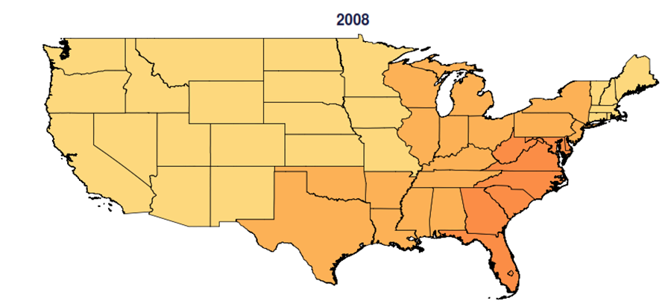
Prevalence of Diabetes and Pre-Diabetes 2008
HCCI 2013, ESI population, diabetes, pre-diabetes and gestational diabetes

Slide 3
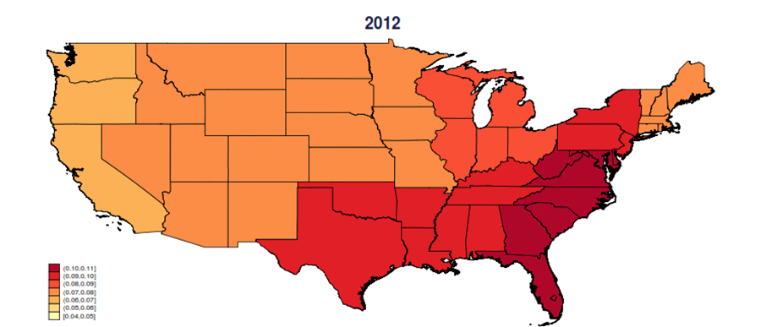
Prevalence 2012
HCCI 2013, ESI population, diabetes, pre-diabetes and gestational diabetes

Slide 4
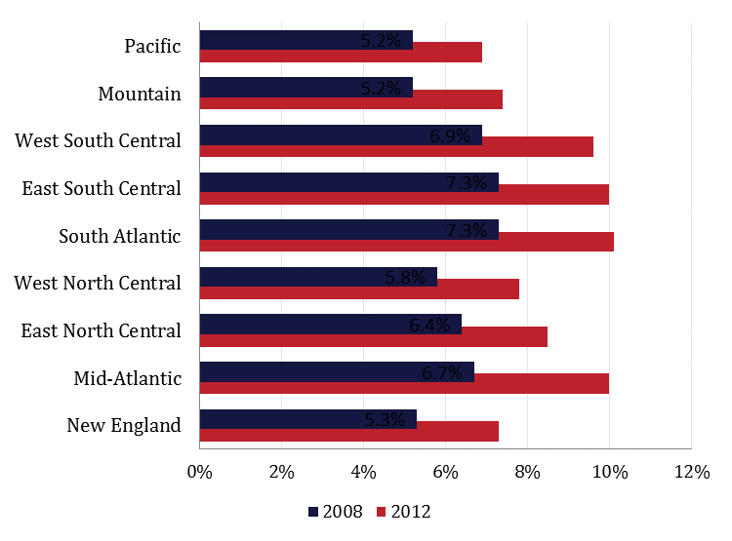
Prevalence by Region
Source: HCCI, 2013

Slide 5
Prevalence of Diabetes and Pre-diabetes Among ESI
Under age 65
Age Group | 2008 | 2009 | 2010 | 2011 | 2012
% of ESI Population | 6.4% | 7.1% | 7.8% | 8.3% | 8.8%
Per 1,000 Insured Months | 64 | 71 | 78 | 83 | 88
Change from prior year | n/a | 12.0% | 9.2% | 7.2% | 5.4%
Adults by age | 2008 | 2009 | 2010 | 2011 | 2012
26-44 | 4.1% | 4.8% | 5.3% | 5.8% | 6.1%
45-54 | 10.1% | 11.4% | 12.4% | 13.5% | 14.3%
55-64 | 18.5% | 20.4% | 21.8% | 23.1% | 24.0%
Source: HCCI, 2013
ESI = Employer Sponsored Health Insurance

Slide 6
The Population Value of Quality Indicator Reporting: A Framework for Prioritizing Health Care Performance Measures
David O. Meltzer, University of Chicago
Jeannette W. Chung, Northwestern University
Abstract
The Agency for Healthcare Research and Quality (AHRQ) National Healthcare Quality and Disparities Reports contain more than 250 quality indicators, such as whether a patient with a suspected heart attack received an aspirin. The Department of Health and Human Services National Quality Measures Clearinghouse identifies more than 2,100 such indicators. Because resources for making quality improvements are limited, there is a need to prioritize among these indicators. We propose an approach to assess how reporting specific quality indicators would change care to improve the length and quality of life of the US population. Using thirteen AHRQ quality indicators with readily available data on the benefits of indicator reporting, we found that seven of them account for 93 percent of total benefits, while the remaining six account for only 7 percent of total benefits. Use of a framework such as this could focus resources on indicators having the greatest expected impact on population health.
Health Affairs, January 2014, pp 132-139

Slide 7
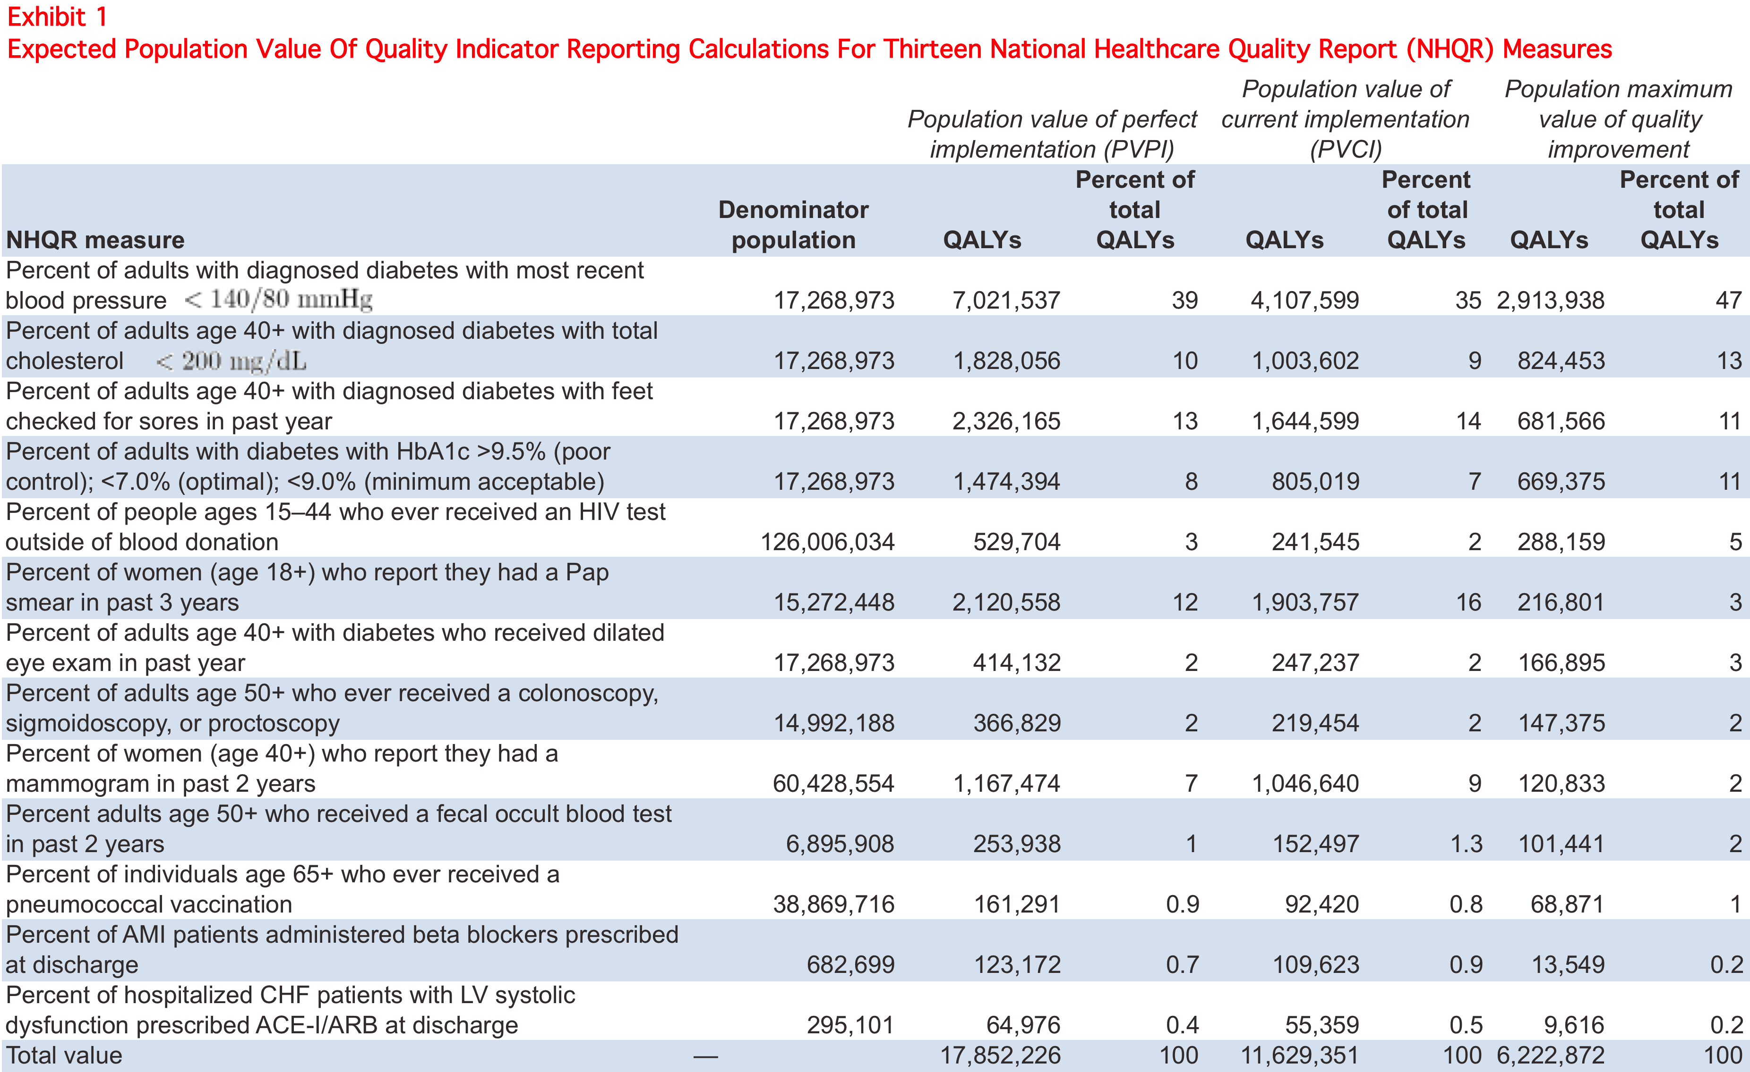

Slide 8
Beacon study: HgbA1c Results By Care Model

Slide 9
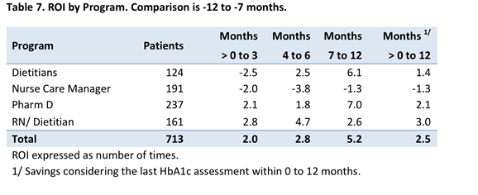
Most Conservative ROI Estimate to account for potential Regression to the Mean
Comparing HgbA1c at -12 to -7 months prior to enrollment to +7 to +12 months post-enrollment

Slide 10
Intervention Costs

Slide 11
Discussion
Anthem’s Enhanced Personal Health Care program (formerly PC2): estimated management capitation of $3.50 pm/pm, risk adjusted (i.e., higher for patients with diabetes)
Other carriers also have primary care programs
Proposition: it’s worthwhile for providers to invest in this high cost population

