Slide 1
Update for healthcare stakeholders: IN211 Healthcare Project and IaUW Navigator Grant
January 2014

Slide 2
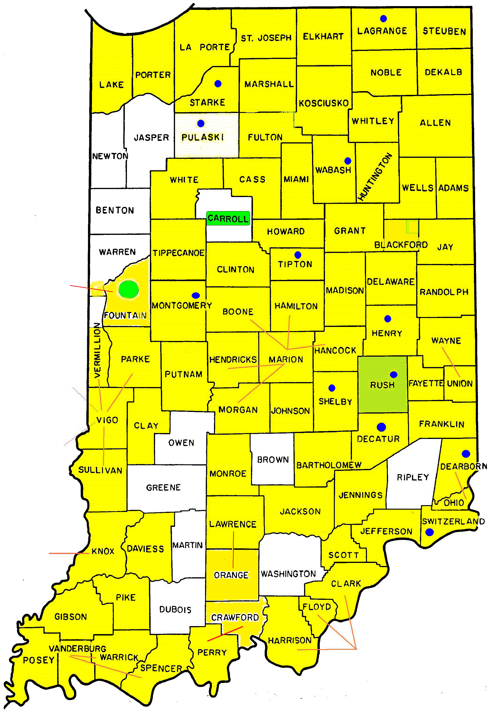
Indiana’s United Ways support:
Agencies and programs such as health clinics, Little Red Door Cancer Agency, Mental Health America, Visiting Nurses, disease-specific organizations and support groups, new parent visiting, YMCAs.
Health initiatives such as anti-smoking, anti-obesity, “get fit” and immunization campaigns, farm-to-school programs, summer food outreach, substance abuse prevention, etc.
Public Policy – IaUW supports evidence-based programs and policies that increase the number of insured Hoosiers, improve the quality of healthcare services and reduce risky behaviors. IaUW helps educate about implementation of the healthcare law, especially as it impacts nonprofits and donors. IaUW supports coverage expansion that results in Hoosiers having health insurance with access to healthcare.

Slide 3
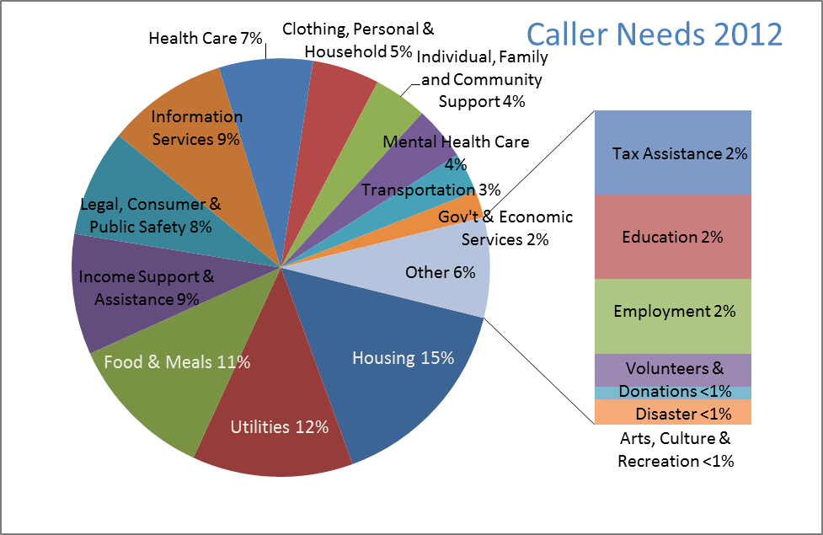
2-1-1 connects people with needs to services in communities
IN211 will ask a subset of callers: “Does everyone in your household have health insurance?”
If uninsured, the caller is offered a pre-screening, information and referrals.
A percentage of callers will receive follow-up calls to ask if services were received and if any further help is needed.
www.in211.org

Slide 4
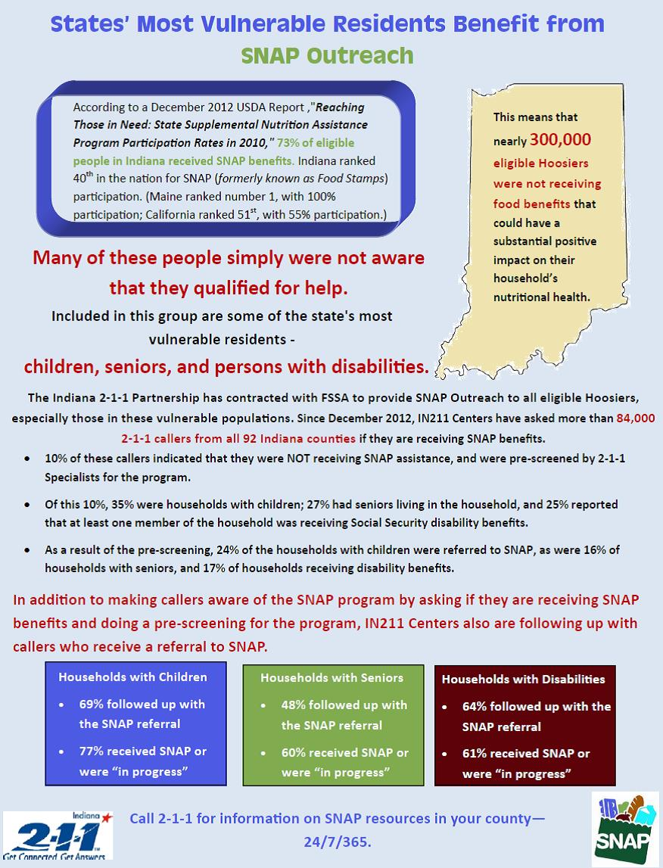
SNAP Outreach
The IN211 Healthcare Project is based on the experience with State of Indiana’s SNAP Outreach Plan.
IN211 assesses SNAP participation of a subset of callers and offers pre-screening and referrals to SNAP, food pantries and related services.
IN211 provides outreach statewide.
IN211 provides detailed data, including information about outcomes.
Sample report at right; more avail at http://www.in211.dreamhosters.com/reports/

Slide 5
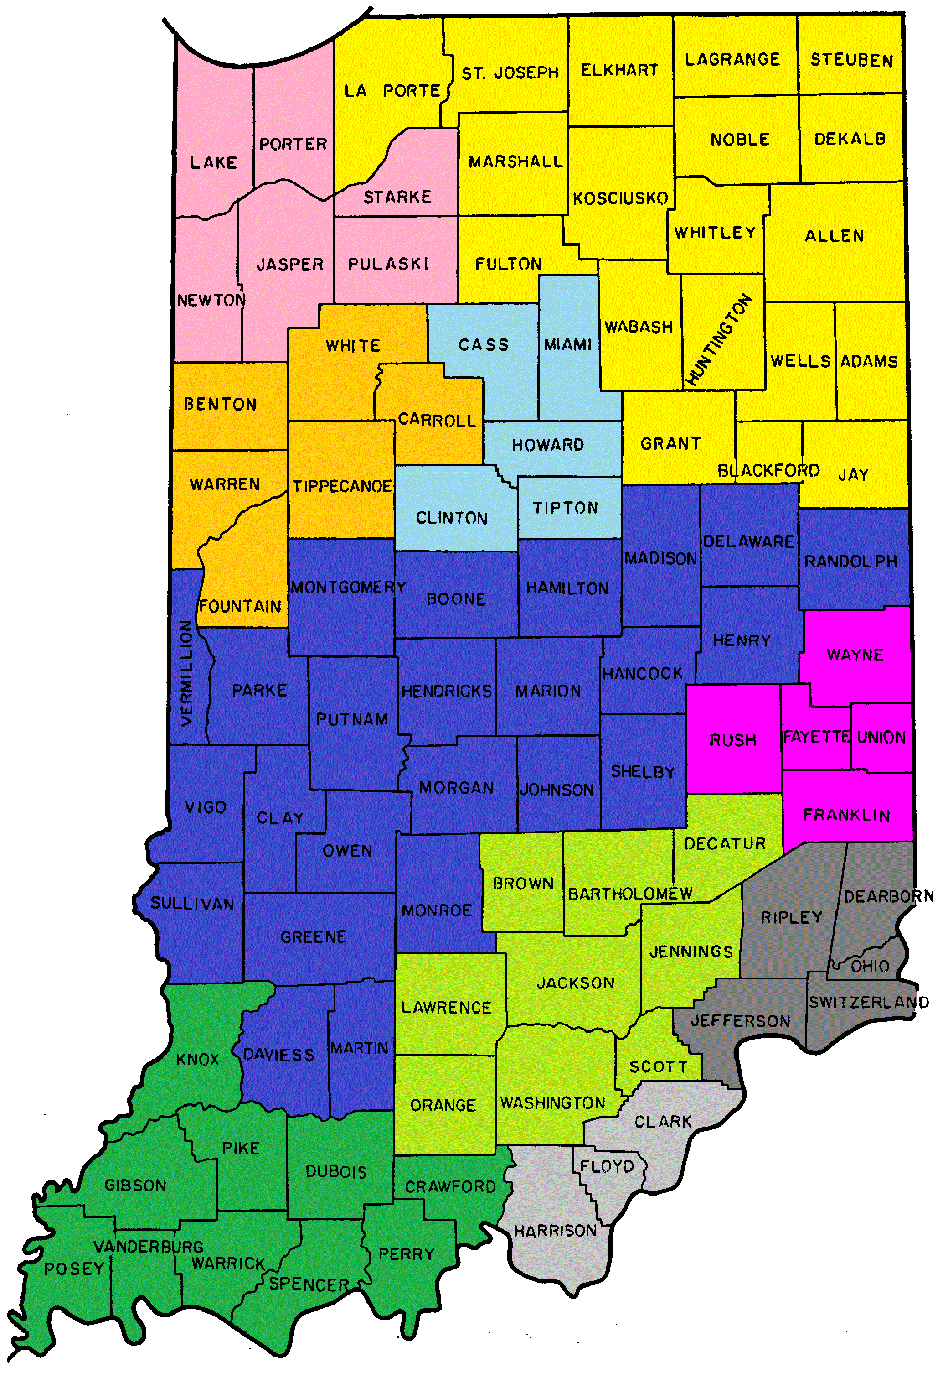
IN211 Healthcare Project
IN211 and its Centers:
maintain information about new healthcare options including detailed information about certified Indiana Navigators;
provide pre-screening and referrals to a subset of callers;
maintain a master calendar of healthcare outreach and enrollment events; and
provide regular reports to healthcare stakeholders about resources, needs, gaps and trends.
IN211 Center Service Areas

Slide 6
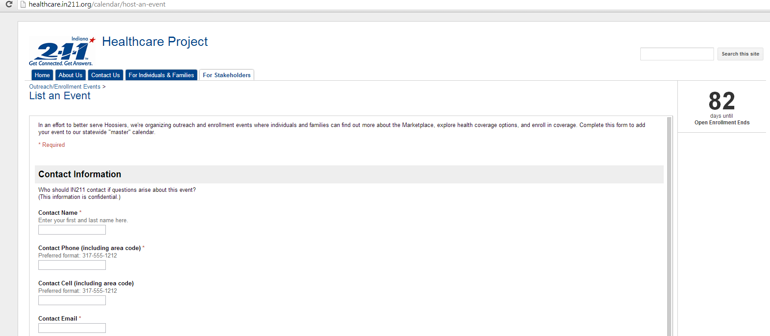
Healthcare.in211.org features
Information for people seeking help and for healthcare stakeholders
Countdown of Open Enrollment
Easy ways to submit Outreach and Enrollment Events online

Slide 7
Navigators – Resources and Gaps
IDOI reports – As of early January, there were nearly 700 individual certified navigators in 130 applicant organization sites.
A challenge for consumers – While there are many Navigators and events, it is hard to find out about them.
A challenge for IN211 – Of the organizations listed with IDOI, only a subset was accepting referrals from IN211, citing lack of capacity to serve individuals outside of their own client base.

Slide 8
Ways you can help
If your Organization…
provides Navigator services, please complete the form for listing in the IN211 Database.
hosts an event, please post your event on our Master Outreach and Enrollment Event calendar.
serves uninsured, please post flyers, encourage them to call 2-1-1 or consider hosting an event.
observes barriers, needs or trends, please contact us.
See http://healthcare.in211.org

Slide 9
Navigator Grant Background
The federal Centers for Medicare and Medicaid Services (CMS) announced in Aug. 2013 a grant through United Way Worldwide for Indiana. Other CMS-funded Navigators included: ASPIN, Eskenazi and Plus One. Additionally Federally Qualified Health Centers (FQHCs) and Cognosante received funds to encourage enrollment as assisters.
Initially, United Way the grant included support for IN211 for a role in data management, pre-screening, referrals and facilitated enrollments.
Post award announcement, CMS required a re-design of the project. Consequently, IN211 is not a sub-recipient of the United Way Worldwide/Indiana Association of United Ways award.
Working with key healthcare stakeholders, IaUW continued negotiations with CMS to redesign Navigator project to meet needs in underserved areas, with an eye toward long-term capacity for enrollment assistance.

Slide 10
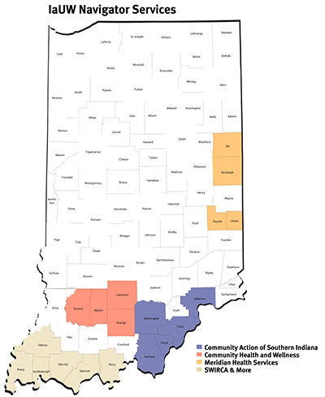
IaUW Navigator Organizations
Community Action of Southern Indiana (Clark, Floyd, Harrison, Washington and Jefferson Counties)
Community Health and Wellness (Lawrence, Orange, Martin and Daviess Counties)
Meridian Health Services (Jay, Randolph, Fayette and Union Counties)
SWIRCA & More (Perry, Posey, Gibson, Warrick, Spencer and Vanderburgh Counties)

Slide 11
Communications
With private funding, IN211 provides pre-screening and referrals to Navigators, as well as publishes a statewide Outreach and Enrollment calendar.
Call 2-1-1 or visit http://healthcare.in211.org
Brian Metzler, IN211 Healthcare Project Coordinator, brian.metzler@in211.org, 574-239-2241
Peggy Matson, IN211 Healthcare Resource Specialist, peggy.matson@in211.org, 317-735-7598
IaUW Navigator Grant
Julie Koegel, project coordinator, julie.koegel@iauw.org
Lucinda Nord, lucinda.nord@iauw.org, 317-502-8504

Slide 12
Contact info
Lucinda Nord
VP, Public Policy
Indiana Association of United Ways
3901 N. Meridian St., Ste. 306
Indianapolis, IN 46208-4026
1-800-457-1450, ext 131
Desk 317-921-1394 / cell 317-502-8504
Lucinda.nord@iauw.org
View PP Updates Archives
and
Sign up at www.iauw.org

